Slide 1
Social Desirability Bias

Slide 2
Definition
“[T]endency to answer questionnaires or surveys according to what is socially acceptable” (Stephanie)
Politically correct or popular answer

Slide 3
Example 1
Inaccurate survey topics: abortion, drug use, or prostitution
Attributed to: embarrassment or lack of comfort in revealing true feelings or attitudes
Solutions:
Indirect questions
Forced choice items
Proxy subjects
(Stephanie)

Slide 4
Other Instances
Personal income and earnings, often inflated when low and deflated when high [towards average]
Compliance with medicinal dosing schedules, often inflated
Involves self-deception

Slide 5
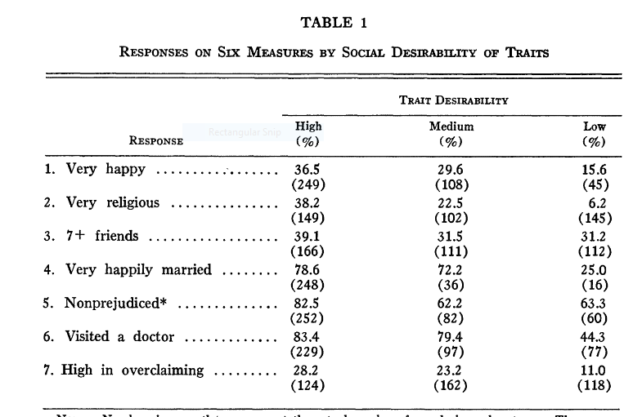
Study

Slide 6
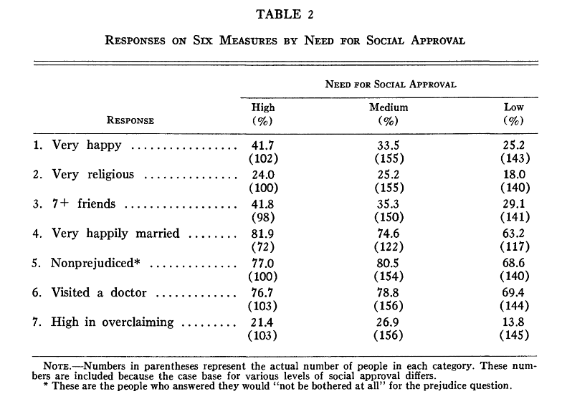
Study

